Slide 1
Hub Selection plan
Kevin | Anthony | Nina

Slide 2
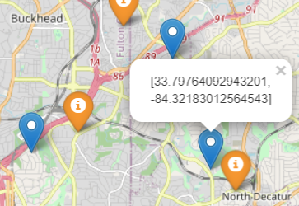
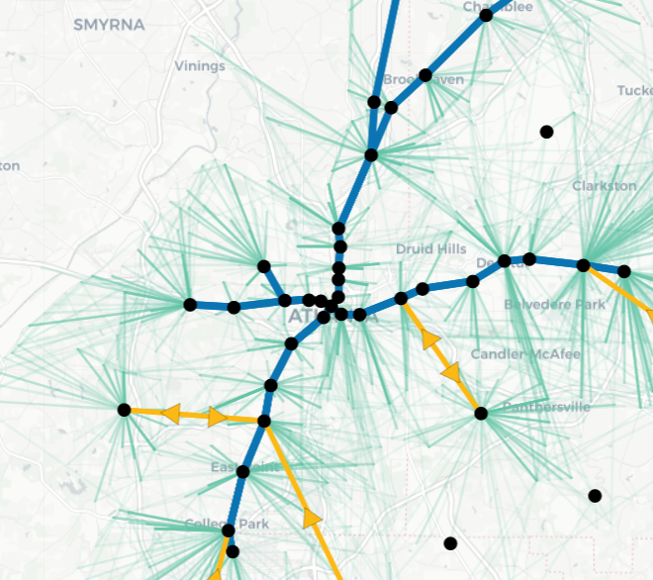
The Big Picture
Identify potential hubs for current situation
Machine Learning / clustering (DBSCAN, WEIGHTED K-MEANS, etc)
Obtain a large set of hubs
Solve simplified network design problem to get smaller set of hubs
Plan A: More coarse clustering of od-pairs (reduce shuttle legs)
Plan B: Adding hubs in limited regions
Generate new network design based on the smaller set of hubs
Fix selected potential hubs
Go back to step 1
Region 2
Region 1

Slide 3
Week 1 Plan
Region 1
Identify potential hubs using DBSCAN
Split potential hubs into different regions
Simple variant of Plan b (don’t fix anything in the current network design)
Consider a region
Add potential hubs of this region to the current set of hubs
Solve the network design problem
Potential hubs selected by the design become “small hub set candidates”
Remove all hubs added and consider another region until City of Atlanta is covered
Solve the global network design problem with all small hub set candidates
Do we really see improvement?

Slide 4
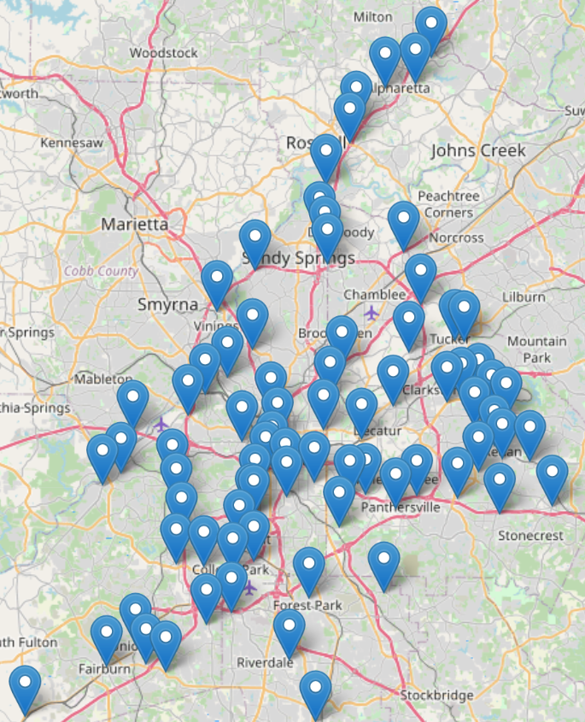
Week 1 Progress
1 | 2 | 3 | 4
5 | 6 | 7 | 8
9 | 10 | 11 | 12
13 | 14 | 15 | 16
Split potential hubs into different regions
75 potential hubs
16 regions
Regions with no hub?
They are empty for now due to MARTA data
Will be updated once using large ARC data
Let network design select small hub candidates
Region by region
Narrowed down to 19 potential hubs
Let network design select final candidates
global
8 selected (see next slide)

Slide 5
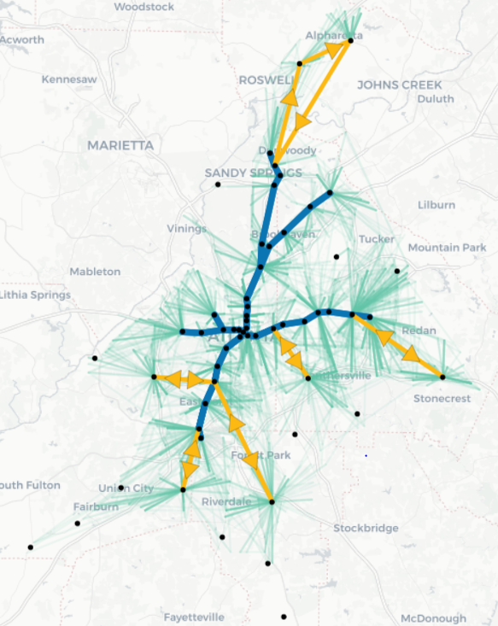
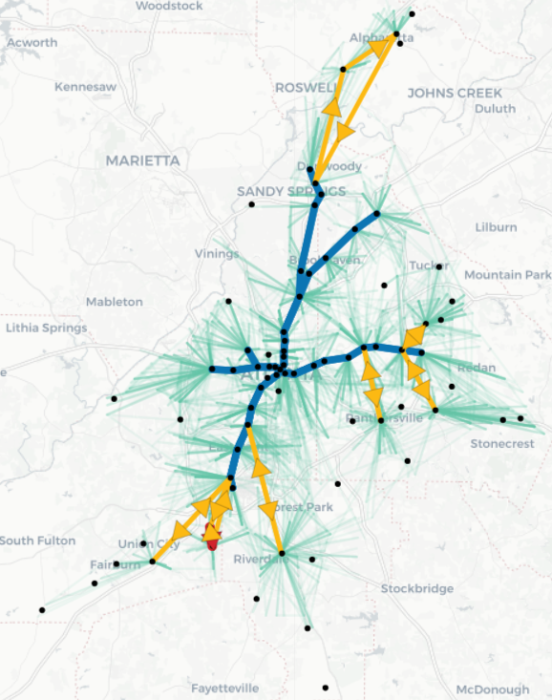
Old vs. New

Slide 6
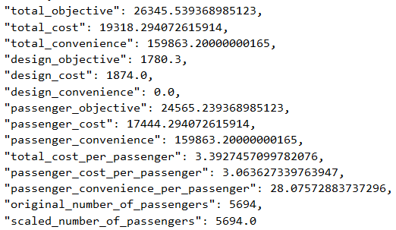
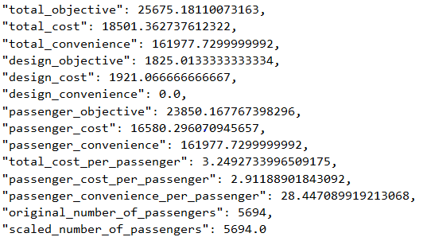
Old vs. New
2.5%
4.2%
1.3%
2.5%
2.5%
2.9%
5.0%
1.3%
4.1%
4.9%
1.3%

Slide 7
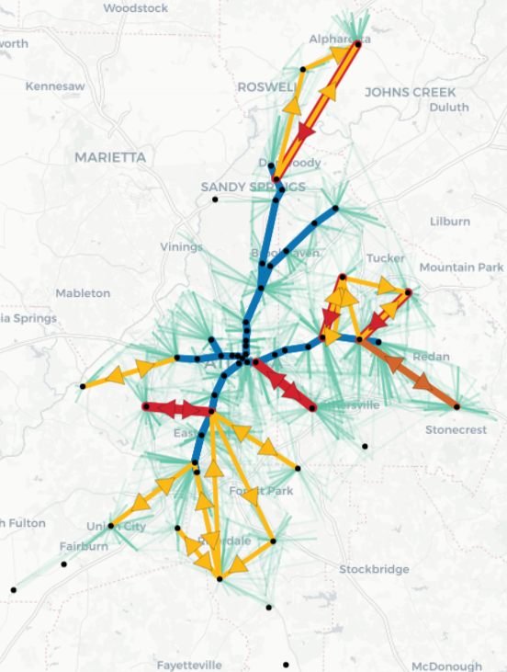
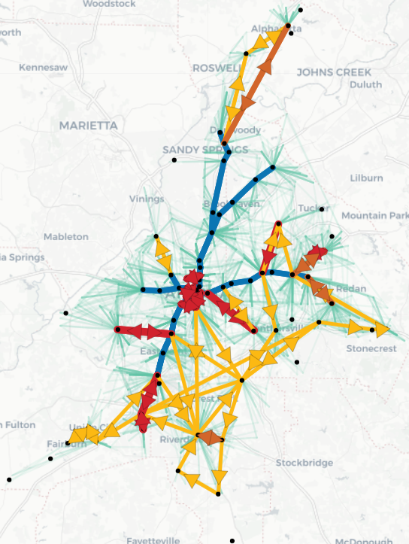
Old vs. New (passenger factor 5)

Slide 8
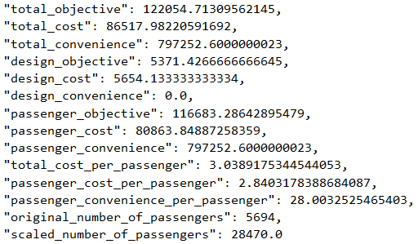
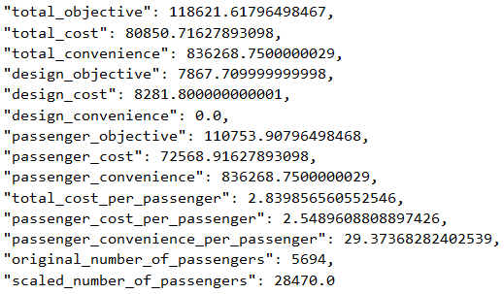
Old vs. New (passenger factor 5)
2.8%
6.6%
4.9%
46.5%
46.5%
5.1%
10.3%
4.9%
4.1%
6.6%
4.9%

Slide 9
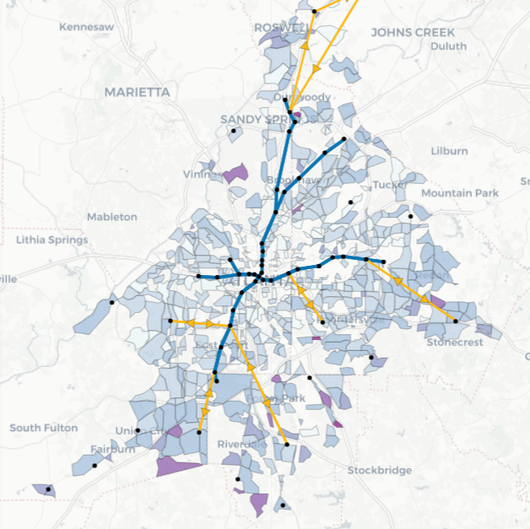
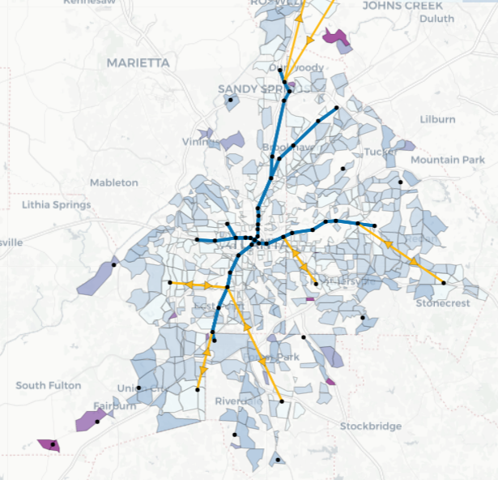
Week 2 Plan
Investigate using passenger specific properties
Current transport cost
Passenger travel time
Number of transfers
Investigate Plan B with fixing part of the network
Reduce computational complexity
Region 1
Region 1

Slide 10
Week 2 Progress
Update potential hub candidates dataset
Get rid of hubs not chosen in the original design
Assign hubs chosen in the original design to a specific region
Re-run design with tuned parameters
travelTimeFactorShuttle = 1.2
travelTimeFactorShuttle = 1.2
alpha = 0.05
mipgap = 0.01
Attempt to fix part of the network (still working on it)
Introducing a hub weight parameter to limit the number of hubs that can be selected from each region
Solve the network design by only considering hubs in a region and its neighbor regions
To-do
Solve runtime issue (takes a long time to generate regional design)
Generate final design
Try other clustering methods

Slide 11
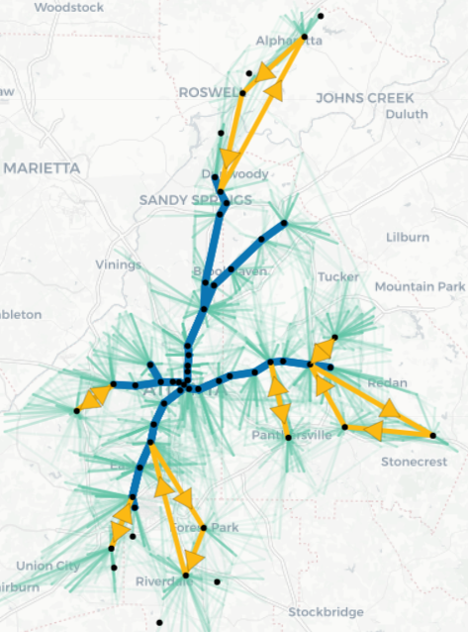
Old vs. New

Slide 12
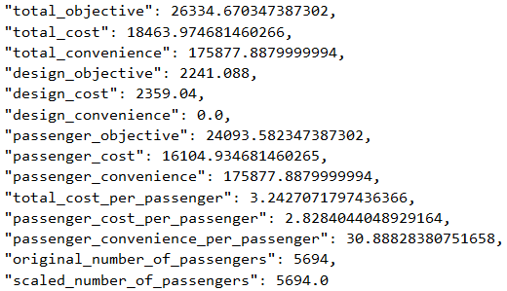
Old vs. New
0.4%
4.4%
10.0%
25.8%
25.8%
1.9%
7.7%
10.0%
4.4%
4.9%
10.0%
Observe greater improvements after parameter tuning

Slide 13
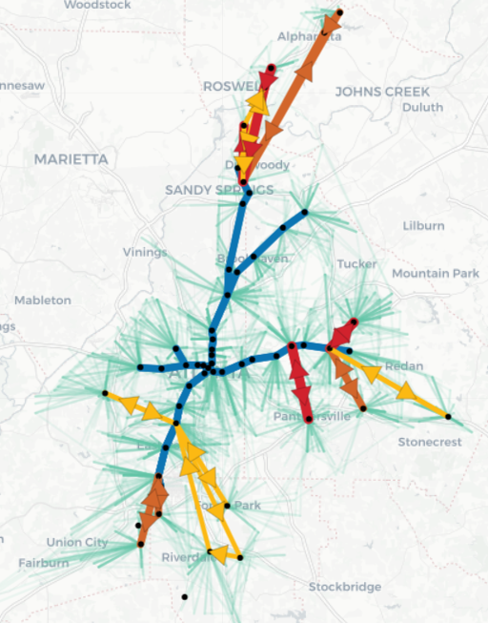
Old vs. New (passenger factor 5)

Slide 14
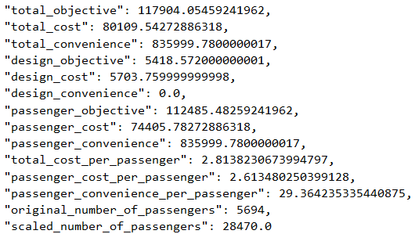
Old vs. New (passenger factor 5)
3.4%
7.4%
4.9%
8.7%
8.7%
4.0%
8.0%
8.9%
4.1%
7.4%
4.9%
Observe greater improvements after parameter tuning

Slide 15
Total Runtime: 497.22 seconds

Slide 16
Week 3 & 4 Plan
Starting using large ARC data
Goal: increase the population that utilize public transit system (currently 2%)
Use it for hub selection
Use it to evaluate current network design (on MARTA data)
Generate new O-D pairs to design
Analysis
Current network design
Hub selection
Case study
Specific region
Areas of improvement
Study robustness
Etc.

